Slide 1

Crystal Mountain Employee Database
By: PJ Ruddy

Slide 2
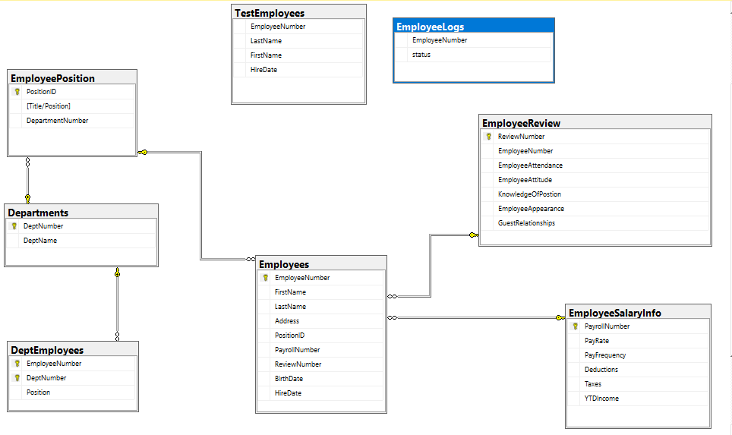
Database Diagram

Slide 3

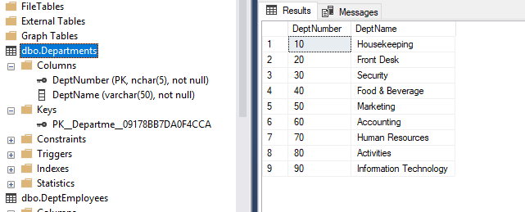
Departments
Table

Slide 4
DepartmentEmployees
Table

Slide 5
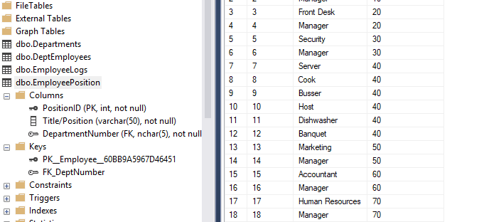
Employee Positions
Table

Slide 6
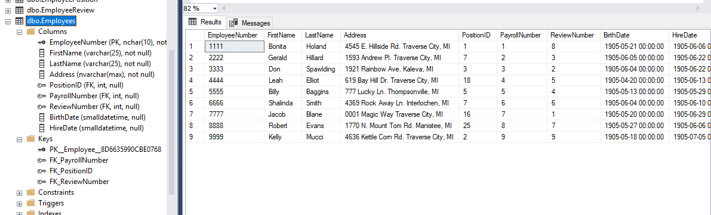
Employees
Table

Slide 7
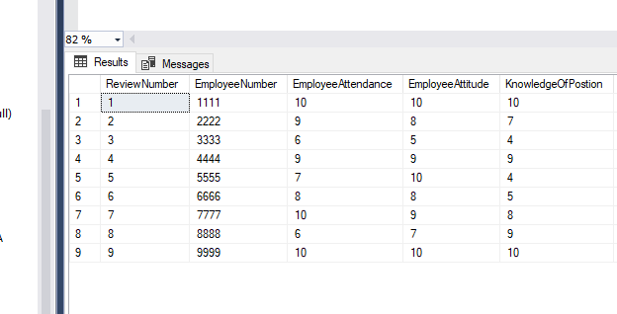
EmployeeReview
Table

Slide 8
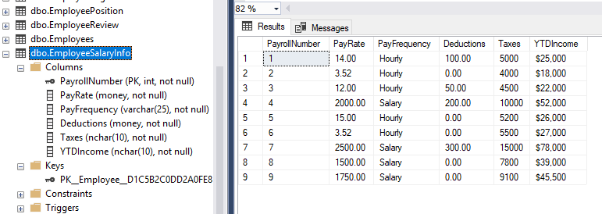
EmployeeSalaryInfo
Table

Slide 9
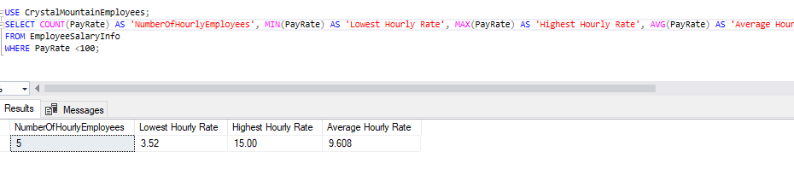
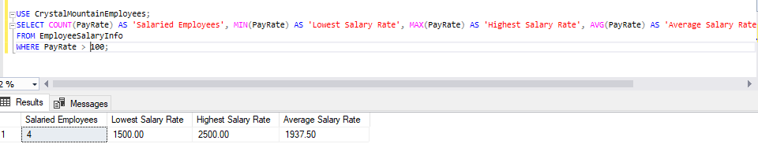
Aggregate Summary Quarries

Slide 10
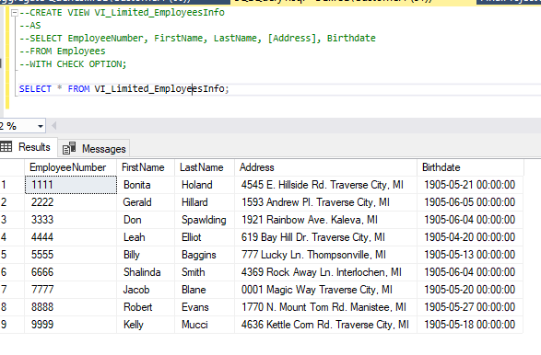
Limited View of
Employee information

Slide 11
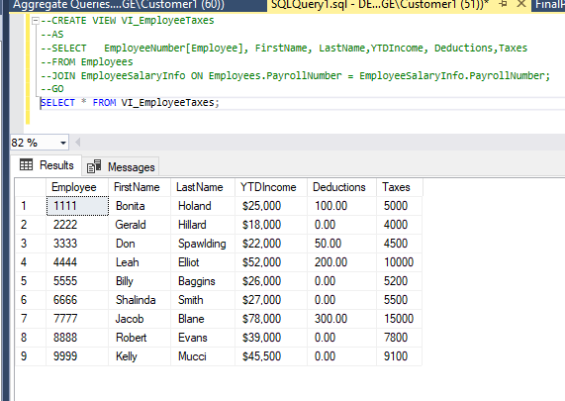
View of Employee Name, Number & Income

Slide 12
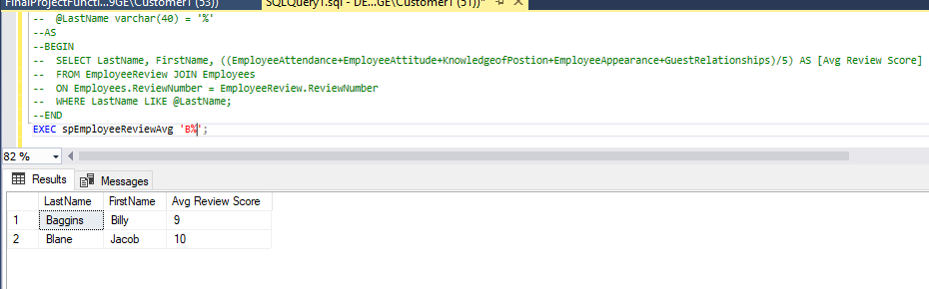
Stored procedure searching avg Review score

Slide 13
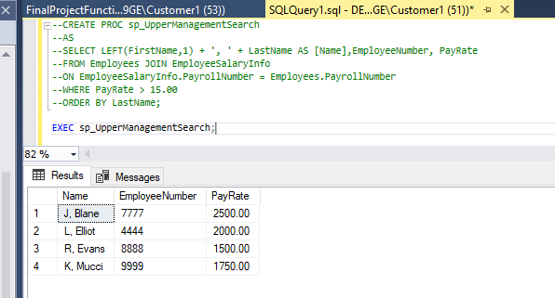
Stored procedure searching Employee Managers

Slide 14
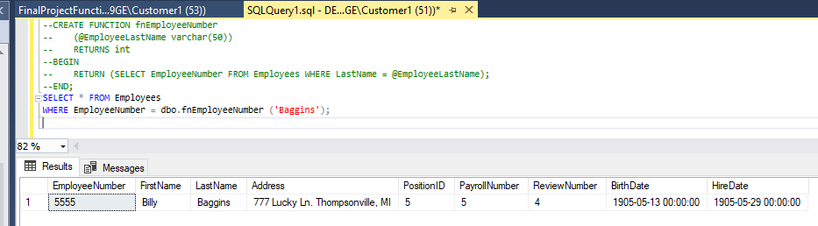
Function searching for employee information using last name

Slide 15
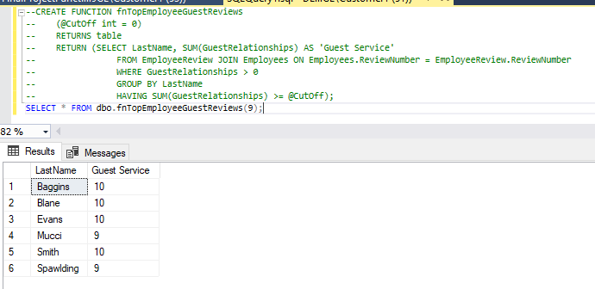
Function retrieving employee with guest review greater than a value

Slide 16
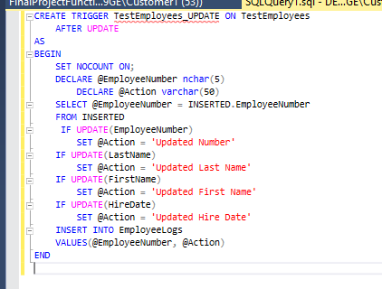
Trigger showing updated employee in Test Employee DB

Slide 17
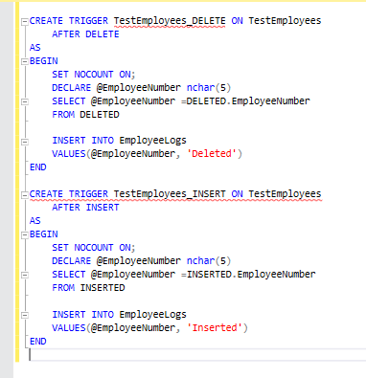
2 Triggers Showing Inserted or Deleted Employees

